Slide 1
What Are The Biggest Influences On IMDb Score?
By: Gabe Stocker, Kyle Aoki, Andy Henze, Emily Callahan & Brian McGrinder
Group 6

Slide 2

What is an IMDb Score?
Score given by qualified users to IMDb.com, a website that originated in 1990 and has given ratings to movies since before 1920
Score is on a scale of 1 to 10 with 10 being the highest
Average score: 6.1
Median score: 6.2
Would be valuable to predict because often times the IMDb score relates to the profitability of the movie
Average vote score for profitable movie: 6.4
Average vote score for unprofitable movie: 5.7

Slide 3

About the Data
Movies Dataset from Kaggle that included the following variables:
Title
Revenue
Budget
Genre
Year
IMDb Score
Actors
Directors
Decided to regress with IMDb score as the y-variable

Slide 4
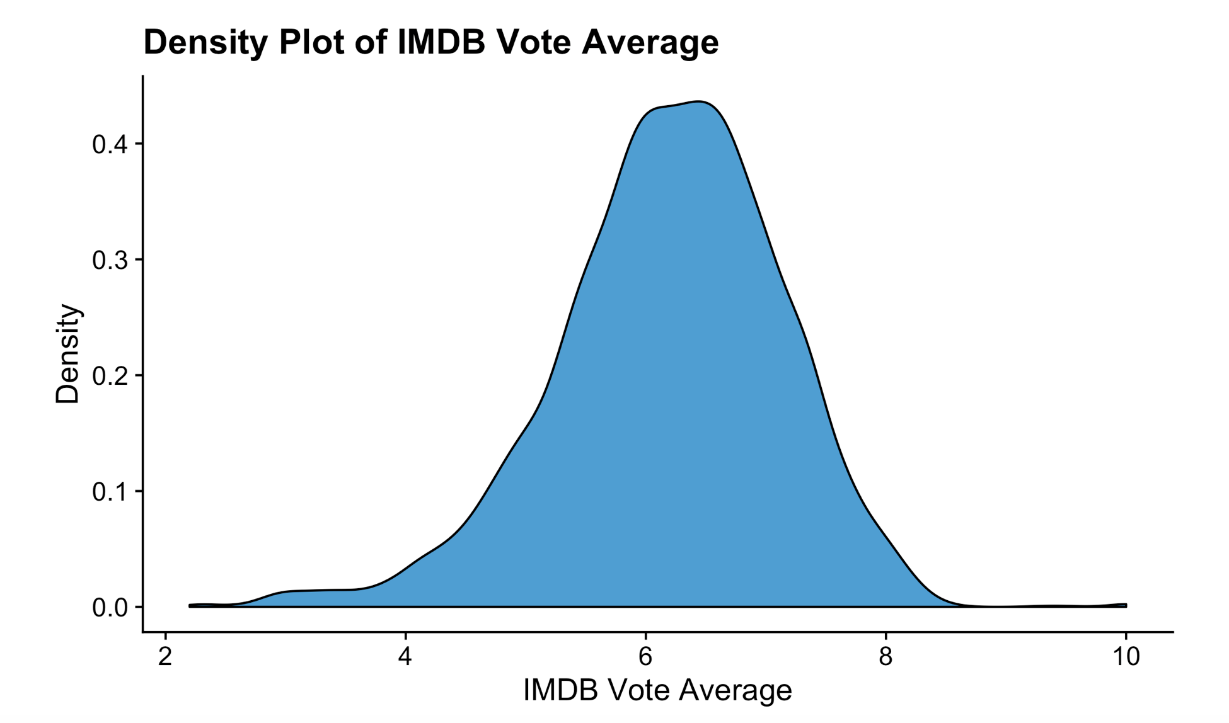
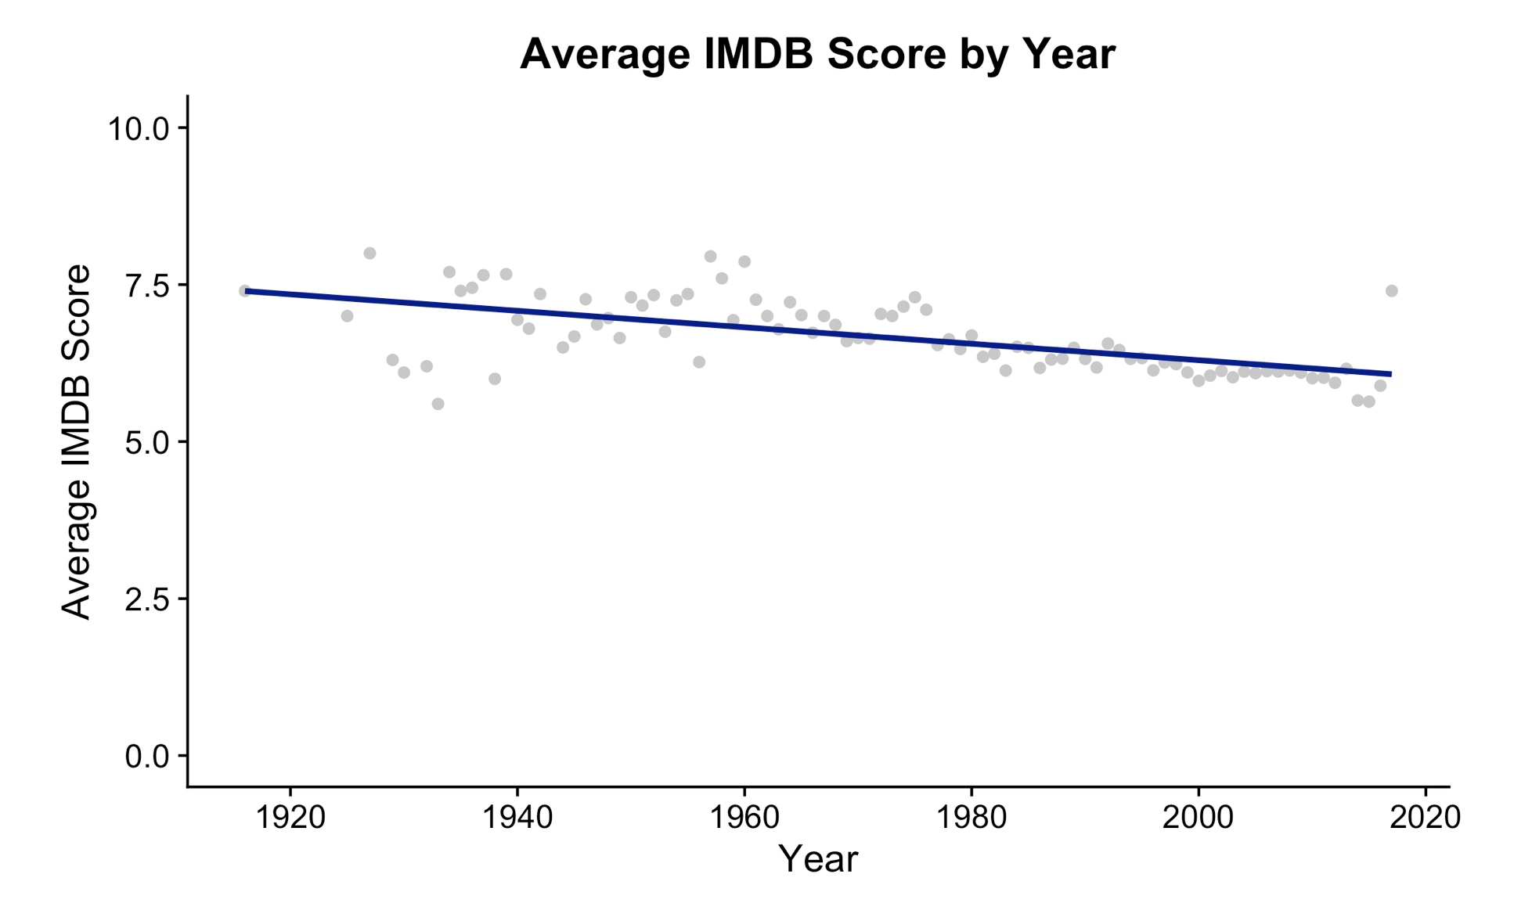
Initial Observations
From the first plot:
Data skewed left
High scores harder to come by than low scores
Majority of movies between 5 and 7
From the second plot:
Somewhat steady decrease in average score over time
Older averages more erratic

Slide 5
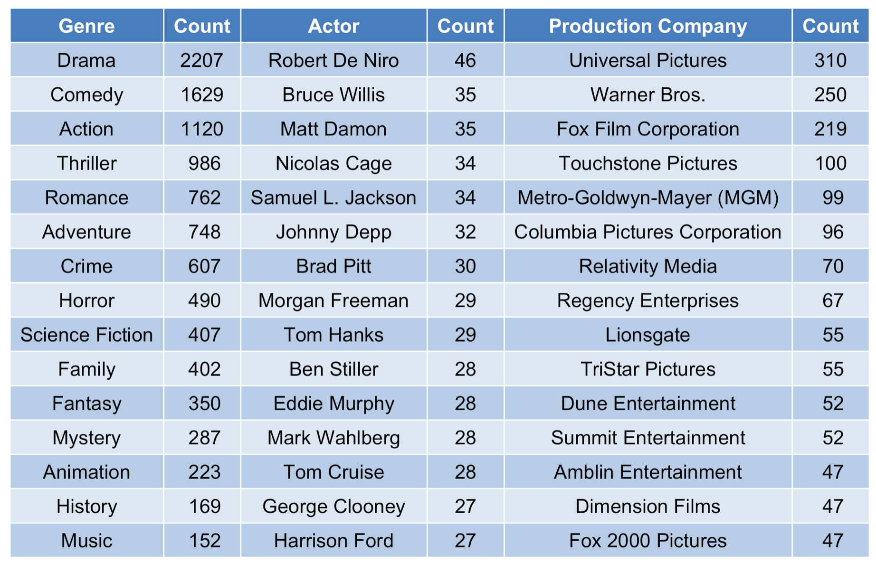
Next Steps
Regression of IMDb score on other variables
Dummy variables given to each qualifying variable (1 or 0)
In order to be included, different variables needed to be observed a certain number of times
Notes:
Explain cut-offs for each variable
Genre- Top 20
Actor- Top 6
Director- Top 4
Production Company- Over 30 Movies ~top 30

Slide 6
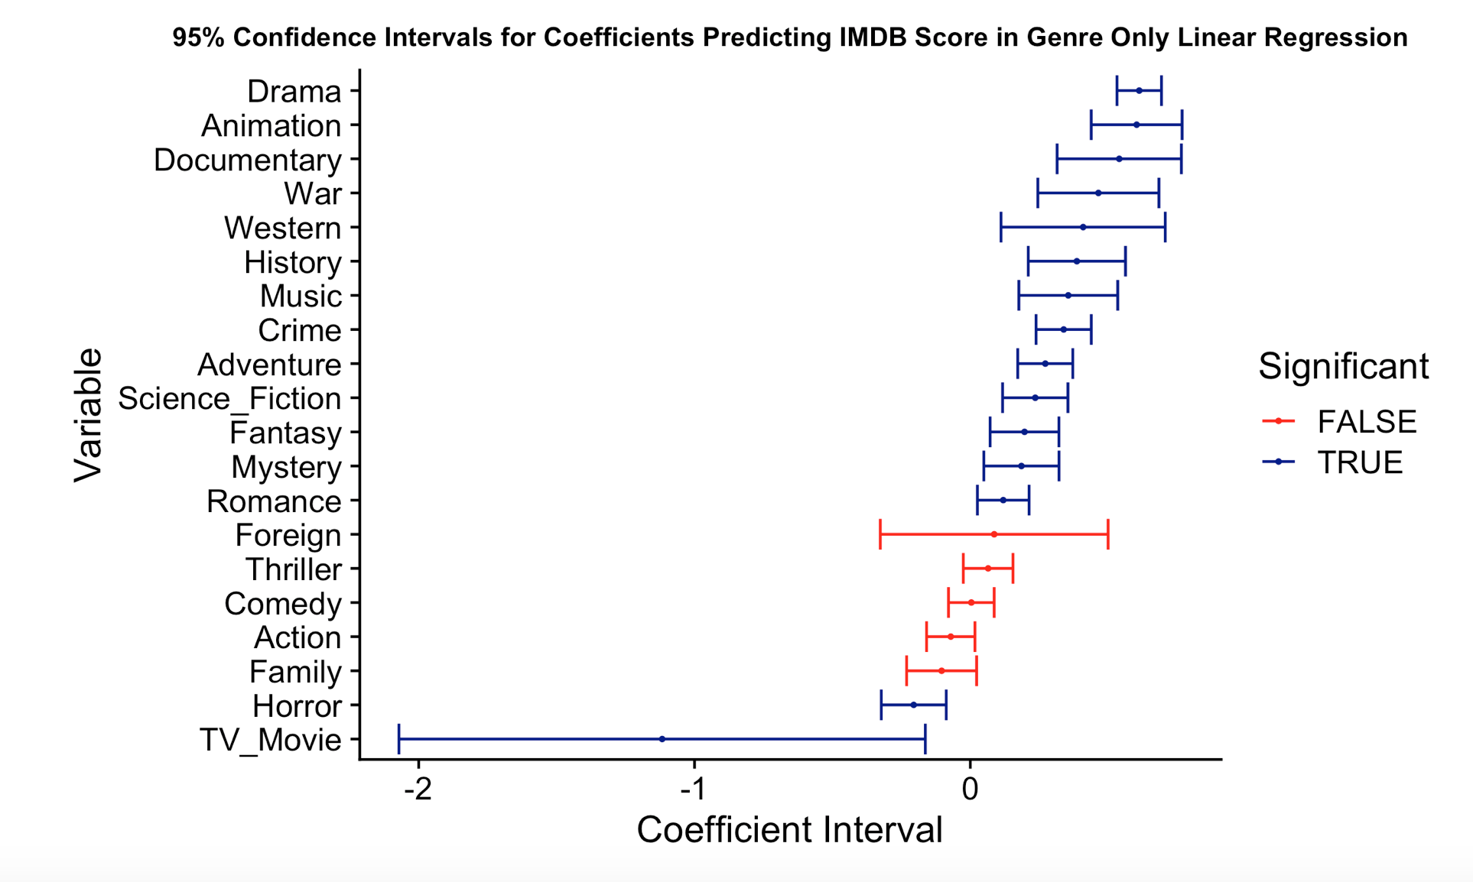
Effects of Genre
Because genre was the most populated factor variable, a regression was conducted to determine the effects of the top 20 genres
15 out of the 20 were seen as significant
Drama most positive, while TV Movie is most negative.

Slide 7
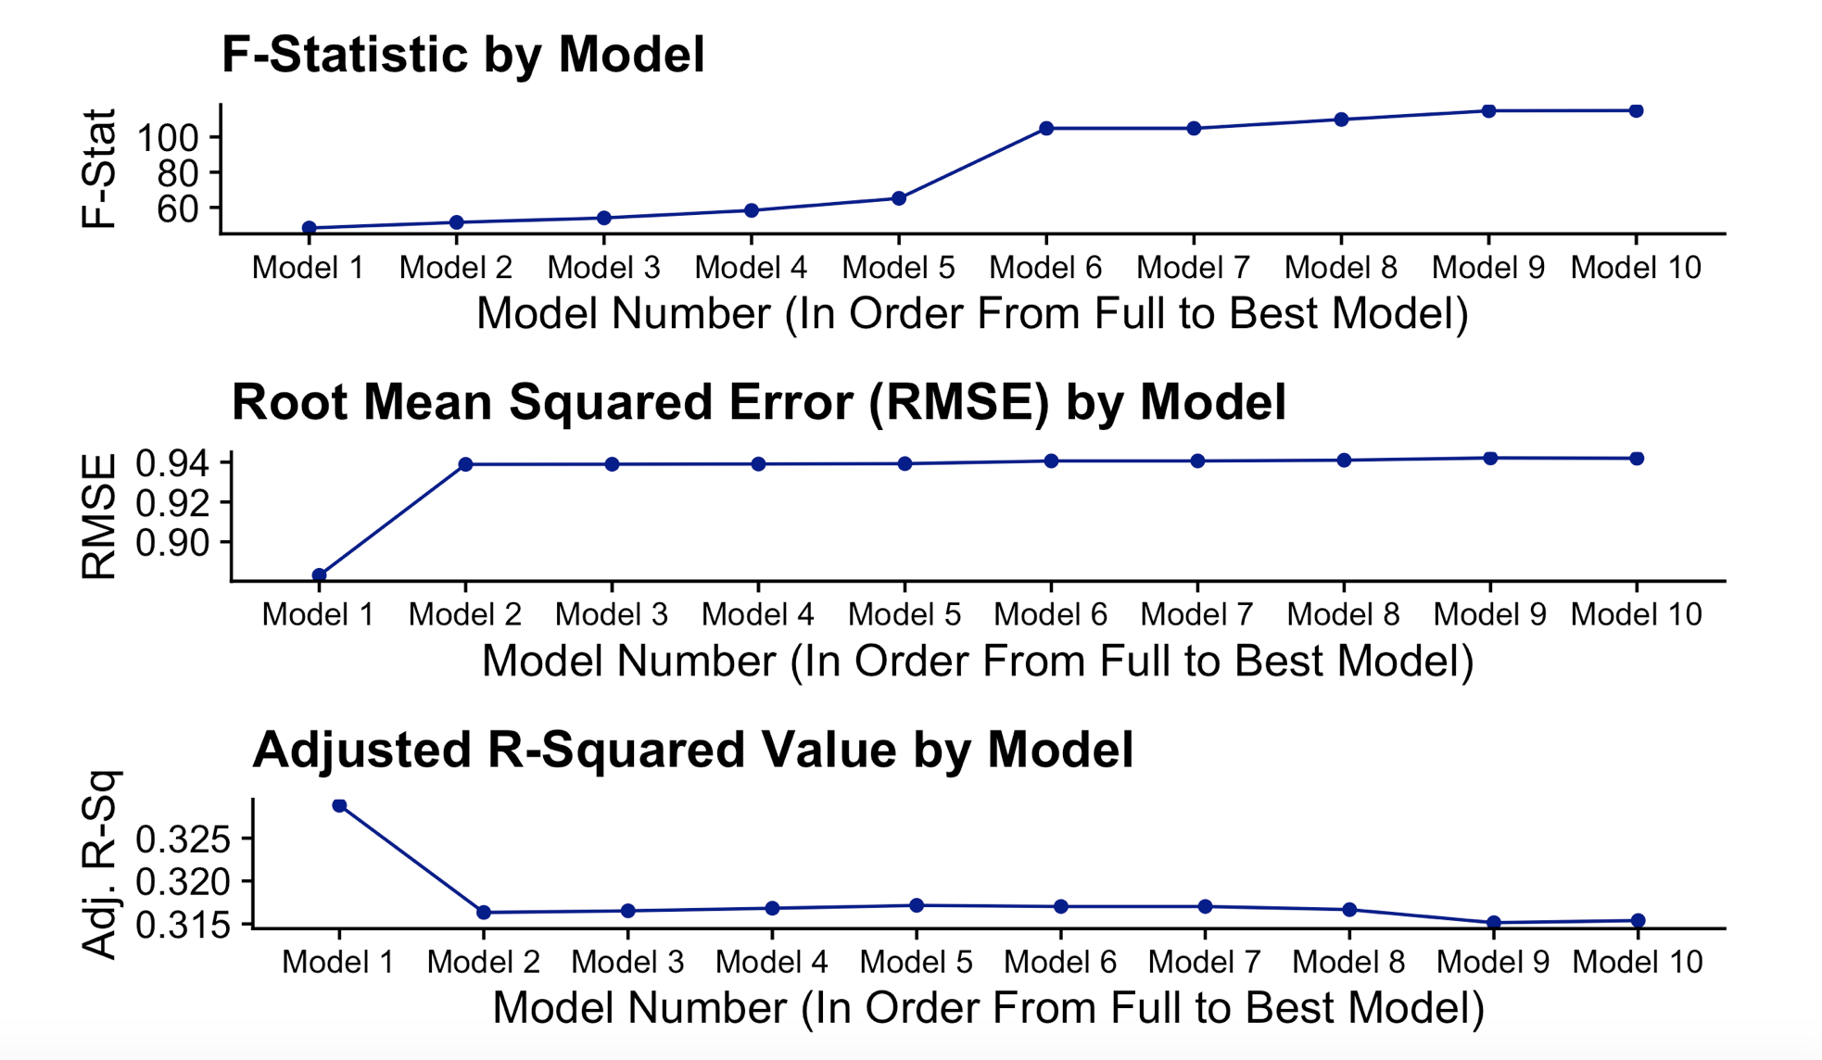
Full Model Creation
Train and test set created by splitting data randomly (70/30).
After selecting which dummy variables to use in each category, we ran a regression with all of the binary variables along with the numeric variables such as year, runtime, revenue, etc..
The model was condensed by removing the 2 to 3 most insignificant predictors while monitoring the F-Statistic, R-squared value, and RMSE.

Slide 8
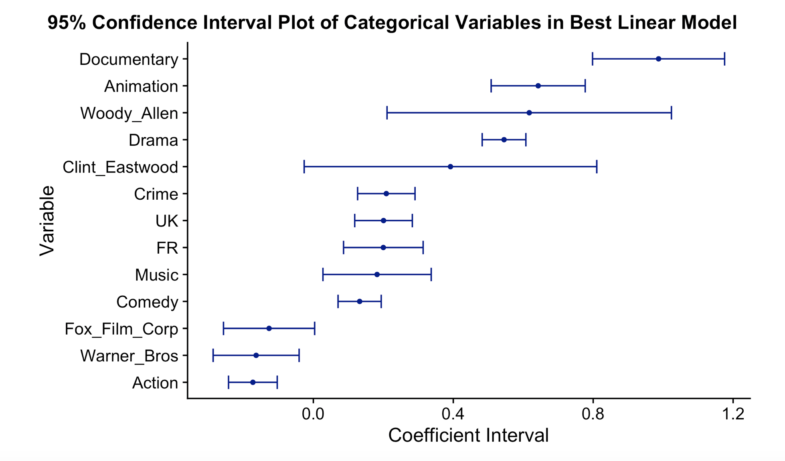
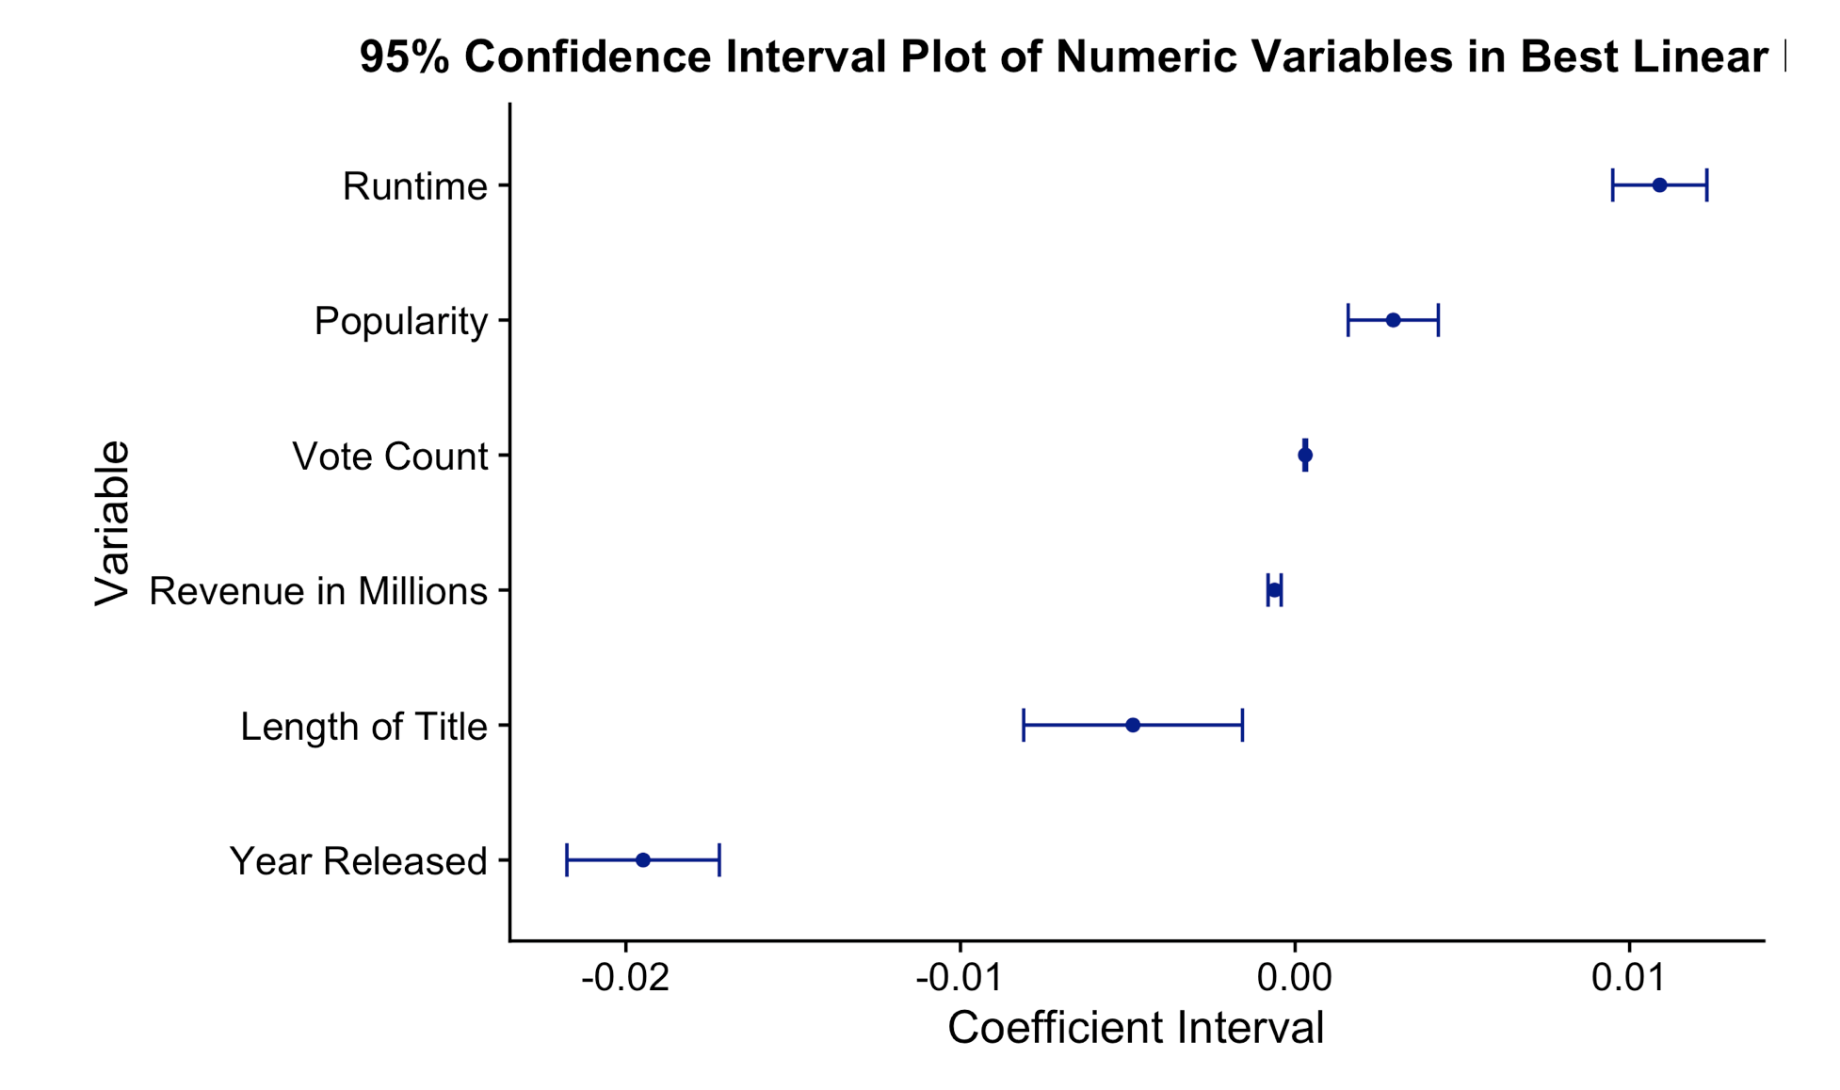
Full Model Creation (cont.)
Model went from 49 predictors down to 19
Insignificant variables removed at each step, until none remained
Year released variable has negative effect, consistent with previous graph
Most numeric variables influential when accounting for scale.

Slide 9
Conclusion
IMDb score can be predicted to an extent (Adj. R^2 ~= 31%).
Information could possibly be used by directors in order to improve their chances at higher score
Could additionally be used to grade movies against similar productions
Possible Improvements:
Additional modeling techniques (K-nn, Decision Trees, Neural Nets, etc.)
More data (dataset only included a random 5000 movies)

